Slide 1
Introduction to Machine Learning for .NET
Ron Dagdag
Notes:
@ankitasthana86 480
@cesardelatorre 2845
@clauren42 154

Slide 2

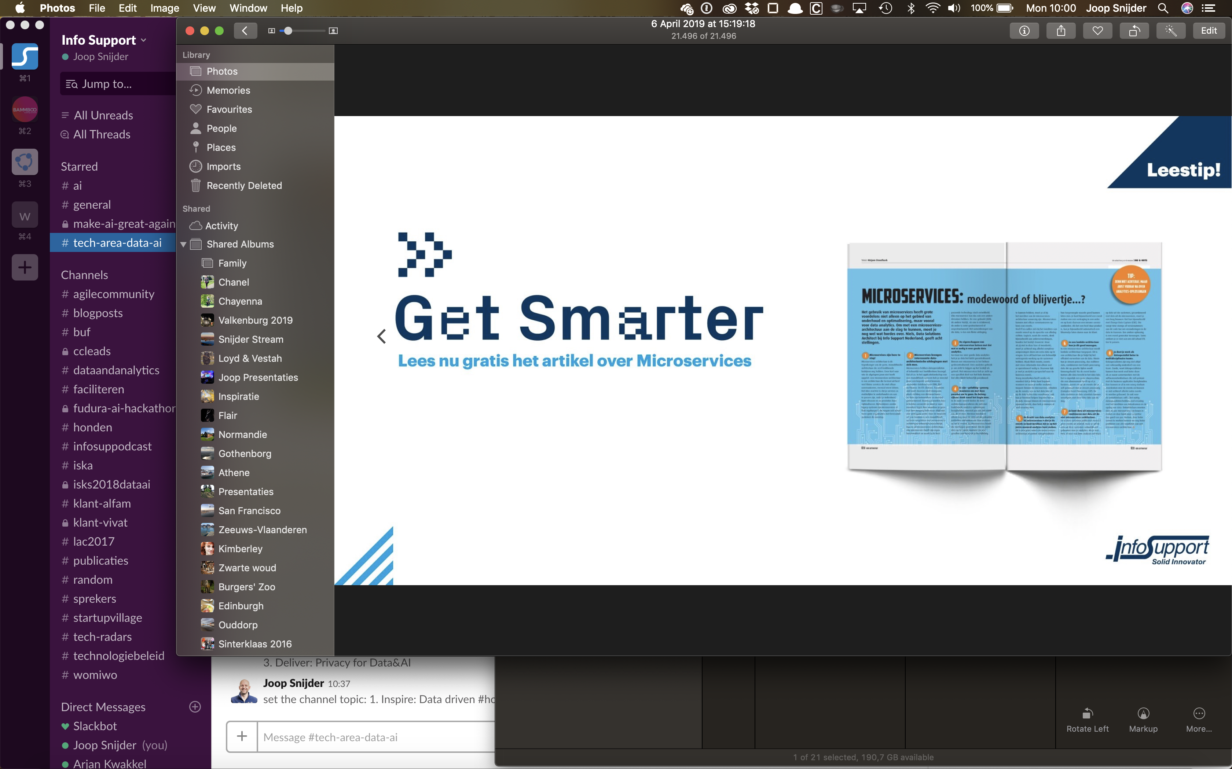
Ron Dagdag
Crestron Electronics
Microsoft MVP Award
@rondagdag
ron@dagdag.net
http://www.dagdag.net/

Slide 3
Introduction

Slide 4

programming
algorithm
answers
input

Slide 5
machine learning
answers
algorithm
input

Slide 6
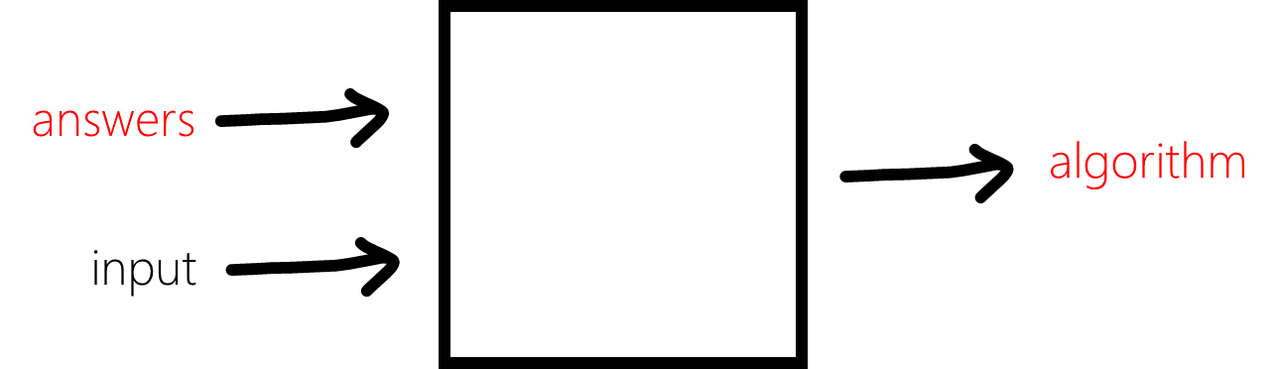
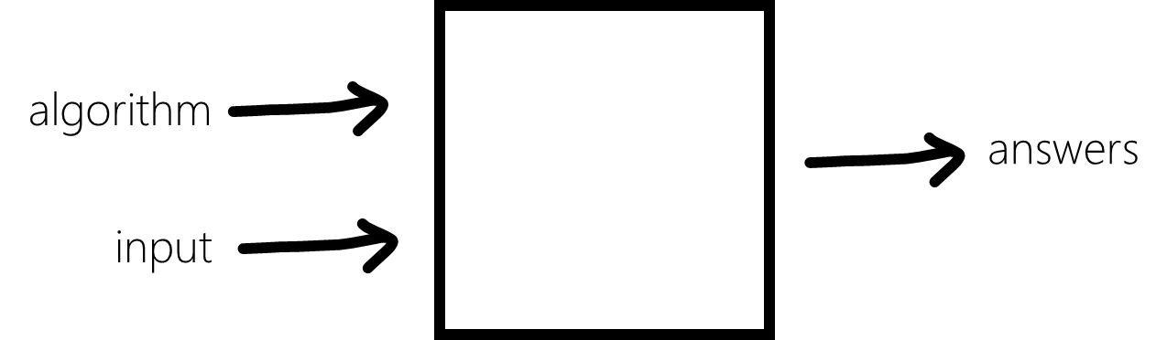
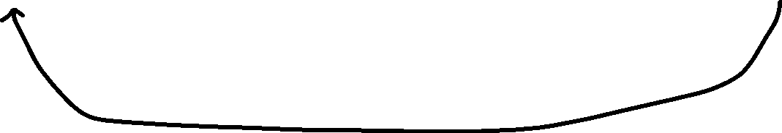
ML Primer
Inferencing
Machine learning
Programming
Training
Data
Training
Framework
Model
Model
Runtime

Slide 7

Machine Learning “Programming the UnProgrammable”
{
{
Is this a face?
Price of Shirt?
f(x)
f(x)
“It has exquisite buttons … with long sleeves …works for casual as well as business settings”

Slide 8



Machine Learning “Programming the UnProgrammable”
{
Machine Learning creates a
Face
Face
f(x) Model
Not a face
Not a face
using this data
Notes:
A model is an intelligent function which can predict

Slide 9


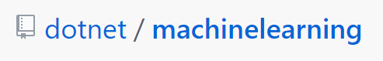
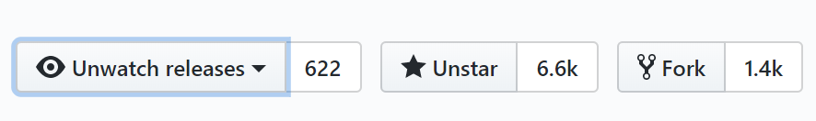
150K+
Downloads
ML.NET Open Source Momentum
1,960
Commits
2,063
Pull requests
135
Contributors

Slide 10

ANNOUNCED @ Build2019
ML.NET 1.0 @Build 2019
ML.NET 1.0
Machine Learning framework for building custom ML Models Custom ML made easy Automated ML and Tools (Model Builder and CLI) Proven at scale Azure, Office, Windows
Extensible TensorFlow, ONNX and Infer.NET Cross-platform and open-source Runs everywhere

Slide 11
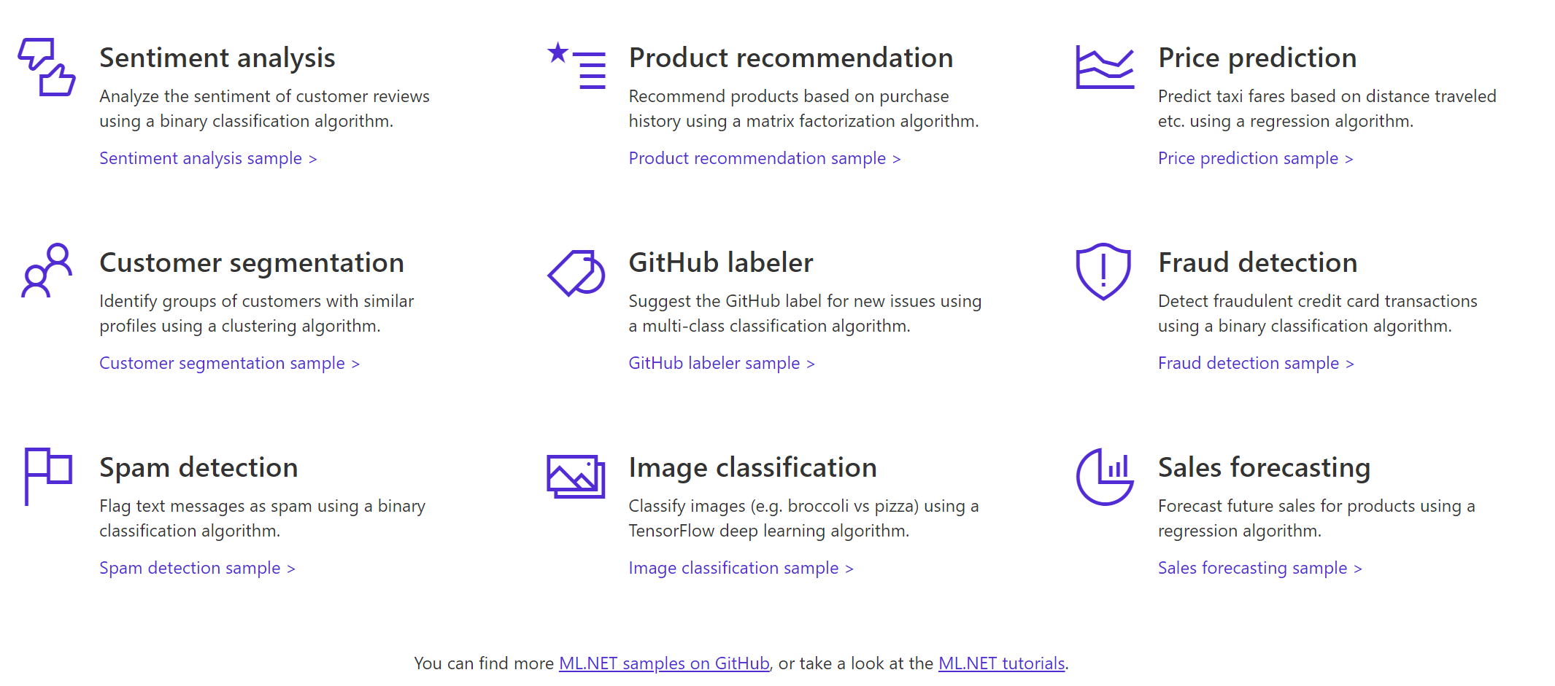

A few things you can do with ML.NET 1.0 …

Slide 12
Three key concepts

Slide 13
1. Data
Data
Example
Comment Text | Sentiment
Wow... Loved this place. | 1
Crust is not good. | 0
Not tasty and the texture was just nasty. | 0
The selection on the menu was great. | 1
Notes:
Dataset: https://github.com/dotnet/machinelearning/blob/master/test/data/wikipedia-detox-250-line-data.tsv

Slide 14
2. Transformers
Data
Data
Transformer
Data
Example
Text
Wow... Loved this place.
Crust is not good.
Not tasty and the texture was just nasty.
The selection on the menu was great.
Featurized Text
[0.76, 0.65, 0.44, …]
[0.98, 0.43, 0.54, …]
[0.35, 0.73, 0.46, …]
[0.39, 0, 0.75, …]
Text Featurizer
Notes:
Transformers take data, do some work on it, and return new transformed data.
One example of a transformer we will need in our example is a Text Featurizer, which takes the text in the issue text and converts it to numbers that our ML algorithms can understand.

Slide 15
3. Estimators
Data
Data
Transformer
Data
Data
Estimator
Transformer
Example
Comment | Sentiment
Wow... Loved this place. | 1
Crust is not good. | 0
Not tasty and the texture was just nasty. | 0
The selection on the menu was great. | 0
Estimator
Model (Transformer)
Notes:
An estimator learns from data to create a transformer. Now a model, which turns the input features into output predictions, is a transformer. So we can take estimators that take our example data and produce a model.

Slide 16
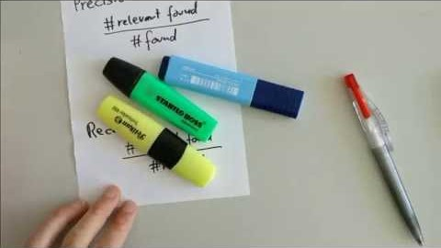
Precision and Recall in 100 Seconds

Slide 17
Time to give ML.NET a spin!
Get started at https://github.com/rondagdag/Workshop-MLNet

